Slide 1
Testing - Overview
Motivation
  fault models
  testing methods
Automatic Test Pattern Generation (ATPG) algorithms
  D-algorithm
  PODEM
  Socrates
  SAT

Slide 2
Testing: Why?
Testing is manufacture verification
  “Is what I manufactured what I designed?”
Incorrect Operation (faults) occurs due to physical defects
  Logical faults
    shorts, missing transistors, …
  Parametric faults
    process variations, die anomalies, …
Faults may be intermittent or permanent
Permanent faults may be created during life of the circuit
  physical/thermal stress
  radiation

Slide 3
Testing: Why?
No manufacturing process can guarantee 100% defect free IC’s
Larger the circuit, greater the probability of defects occuring
Economics: Cost of detecting a faulty component is lowest before it is packaged and embedded in a system and shipped.
Detection (either during manufacture or during operation) of intermittent and permanent faults
⇒ reliable circuits

Slide 4
Fault Modeling and Testing
A fault model is a model of how a physical or parametric fault manifests itself in the circuit. Operation. Fault tests are derived based on these models
Faults
Tests
Logical Fault
  Single/multiple stuck-at (most used)
  CMOS stuck-open
  CMOS stuck-on
  Bridging faults
Parametric faults
  low/high voltage/current levels
  gate or path delay faults
Parametric (electrical) tests also detect stuck-on faults
Logical tests detect stuck-at faults
Transition tests detect stuck-open faults
Timed transition tests detect delay faults

Slide 5
Stuck-at fault test generation
s-a-0
PI
justify
y
propagate
PO
To generate a test for y stuck-at 0, we need to find an vector of primary inputs which sets signal y to 1 (justify) and such that some primary output differs between the good circuit and the faulty circuit (propagate)

Slide 6
Fault Reductions
s-a-0
s-a-0
f1: s-a-1
f2: s-a-1
fault equivalence
fault dominance
Dominated fault: If every test for fault f1 detects f2 , then f1 dominates f2 .
  only have to generate test for f1
Set of faults required for testing is a minimal set with respect to fault equivalence and dominance

Slide 7
Fault Reductions
Stuck fault checkpoints: [Davidson] [Kohavi, Kohavi]
Theorem: In a combinational circuit, any set of tests which detects all single (multiple) stuck faults on
  all primary inputs and
  all branches of fanout points (including primary inputs),
detects all single (multiple) stuck faults.
The set of primary inputs and branches of fanout points are called the checkpoints of the circuit (i.e. checkpoints are the set of faults that are tested)

Slide 8
Checkpoints & fault collapsing
Fault collapsing is the process of reducing the size of the set of faults to be tested, using fault equivalence and fault dominance on the checkpoints of the circuit
x shows checkpoints (s-a-0 and s-a-1 on each checkpoint)
f1 s-a-0 is equivalent to f2 s-a-0. Similarly for other faults.
Exercise: find minimal set of collapsed faults for this circuit. Have to test all sites for both s-a-0 and s-a-1.
c
f2
a
b
f1

Slide 9
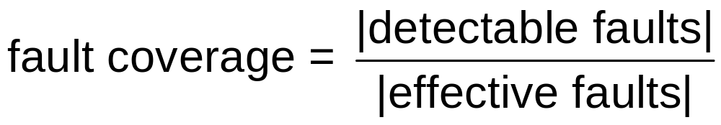
Test Effectiveness
Undetectable fault: No test exists for fault
Redundant fault: Undetectable fault but whose occurrence does not affect circuit operation
Testability = (#detectable faults) / #faults
Effective faults = faults\redundant faults
  (These are the ones we must detect if we want to completely test the chip. Since redundant faults cause no harm, they should not be counted against us.)
(This is a better measure of how well a piece of logic is tested by a set of test vectors.)

Slide 10
Test Effectiveness
Test set size = # of test vectors
Goal:
  100% fault coverage (not 100% testability) with a minimum sized test set

Slide 11
Logic Level Test Generation
Test generation in combinational circuits
  Satisfiability check on Boolean network [Larrabee] [Stephan et al.]
  “Best” solution is SAT based approach (Berkeley experience - not all test community agrees)
Test generation in sequential circuits
  understood only for stuck-at faults
  tests are sequences of vectors
  still impractical on large circuits ( > 30 latches)

Slide 12
Logic Level Test Generation
Convert testing of sequential circuits to testing on combinational circuits by allowing access to memory elements ( “scan design” )
  10-20% area overhead
  10% performance penalty
All combinational test generation algorithms reduce to SAT
  solve SAT problem efficiently

Slide 13
Combinational test pattern generation - Heuristic
Structural search methods: perform search on Boolean space using topology of the circuit as guide.
  D-algorithm [Roth ‘66]
  PODEM [Goel ‘81]
  FAN [Fujiwara, Shimono ‘83]
  Socrates [Schulz et al. ‘88]
SAT based methods:
  [Larrabee 89]
  [Stephan 91]
Symbolic and algebraic methods: Abstract formulation (conceptually elegant but practically infeasible)
  ENF [Armstrong ‘66]
  Boolean differences [Sellers et al. ‘68]

Slide 14
D-Algorithm
Use 5-valued logic for logic value in good (true) and faulty circuit. Implies only one circuit is necessary.
  0 ⇒ 0 in true circuit, 0 in faulty circuit
  1 ⇒ 1 in true circuit, 1 in faulty circuit
  D ⇒ 1 in true circuit, 0 in faulty circuit
  D ⇒ 0 in true circuit, 1 in faulty circuit
  X ⇒ unknown value in either true or faulty circuit
Goal: Find an assignment to primary inputs that causes a D or D at some primary output

Slide 15
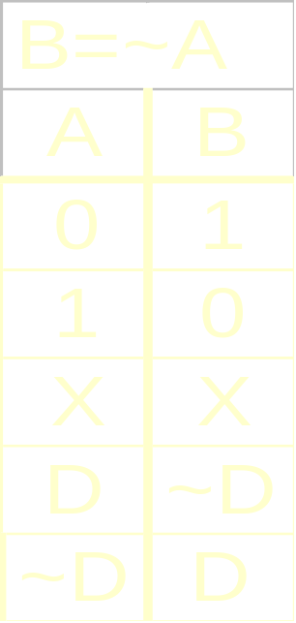
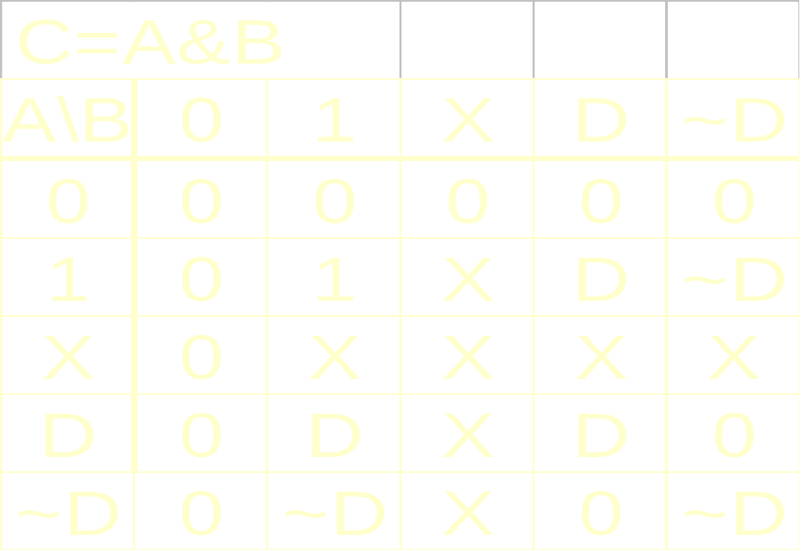
D-Algorithm Calculus

Slide 16
D-Algorithm example
d
s-a-0
1
0
1
c
D
D
j
X
a
0
X
X
i
X
b
0
e
0
Test is abcde = xx110

Slide 17
D-Algorithm
At fault location, determine what value must exist (e.g. for a s-a-0 fault, a D is required)
Assign each internal line of the circuit a value (0,1,D,D,X) which is consistent under some primary input vector. A test exists if such a vector is found (with at least one D or D at an output), otherwise the fault cannot be tested (redundant).
Note: Given n (internal) lines, 2^{n} values need to enumerated in the worst case

Slide 18
End of lecture 16

Slide 19
D-Algorithm: Decision Tree
start
k=1
l =1
“backtracking”
i=1,j=0
i=0,j=1
g=1,h=1
g=0,h=0
c=0,d=0
c=1,d=1
a=0,b=1
a=1,b=0
Search performed level by level from PO’s to PI’s

Slide 20
D-algorithm Problem
e
m
f
n
a
i
b
k
c
j
d
g
l
h
Note that k and l are complementary signals.
Assume k =1, l =1 is chosen as assignment by D-algorithm.
It takes several other assignments before D-algorithm determines this is inconsistent.
Solution: Backtrack only on PI values to determine consistency of signals

Slide 21
Implicit Search Enumeration: PODEM
Actual space of consistent assignments is only 2^{n}, where n is the number of primary inputs
Hence, search space can be greatly reduced (compared to D-algorithm) by enumerating over primary inputs only
PODEM (Path oriented decision making) is such an algorithm

Slide 22
PODEM Decision Tree
start
(All PI’s initially unassigned)
PI₁=0
PI₁=1
(unused alternative assignment)
PI₂=0
PI₂=1
(unused alternative assignment)
(no remaining alternative)
PI₃=1
PI₃=0
(no remaining alternative)
PI₄=0
PI₄=1
PI₄=0
PI₄=1
(conflict: no test)
(conflict: no test)
PI₅=1
PI₅=0
(conflict: no test)
(conflict: no test)
indicates no remaining alternative at node

Slide 23
PODEM: Algorithm
Start with given fault, empty decision tree, all PI’s set to X
3 types of operations performed
  check if current PI assignment is consistent. If so, choose an unassigned PI and set it to 0 or 1
  If inconsistent and if alternative value of currently assigned PI has not been tried, try it and mark this PI as having no remaining alternative
  If no remaining alternative on this PI, backup to previous PI that was assigned, deleting the decision tree below
Algorithm complete: either terminates with a test (all PI’s assigned) or proves fault is redundant

Slide 24
PODEM: Heuristics
Choosing which PI to assign next
  This depends on how the fault could propagate to a primary output
  Choose “closest” PO to which fault can propagate and determine which PI affects the propagation “the most”
  This is done by computing approximate node controllabilities and observabilities
Heuristic is quite ad-hoc.
PODEM is ineffective on large networks with a lot of reconvergence

Slide 25
Socrates
Provides improvements to PODEM
  implications
  static and dynamic learning
Basic Idea
  When a value is set on a node (due to current partial PI assignment) what conclusions can be made?
    Values on other nodes/PI’s
    This allows detection of inconsistencies, thereby causing early backtracking

Slide 26
Implications
b
d
a
f
e
c
a = 1 ⇒ (d = 1) & (e = 1) ⇒ f = 1
Hence, f = 0 ⇒ a = 0
Implications are computed in pre-processing phase and stored for use during backtracking and assignment phase of algorithm

Slide 27
Static and Dynamic Learning
d
b
a
g (dominator)
c
If a has a D value and it must propagate through g, d must be set to 1. If it can’t be, then D on a can’t propagate.
  This is an implication learned from the topology of the network
  a = D ⇒ d = 1
Static learning: implications learned in pre-processing phase
Dynamic learning: implications learned under partial PI assignments

Slide 28
Socrates: Algorithm
Perform implication of each single lead value and store information
Given a fault, determine implied values by static learning
Use PODEM and determine implied values using dynamic learning
Heuristic used to determine when to “learn”
  (e.g. don’t learn implications which are trivial or already known from previous steps)
Socrates completely subsumed by SAT procedure (P.R. Stephan, R.K. Brayton and A. Sangiovanni-Vincentelli, “Combinational Test Generation Using Satisfiability,” IEEE TCAD, Nov. 1992)

Slide 29
Boolean Network Satisfiability
Problem: Given a Boolean network, find a satisfying assignment to the primary inputs that makes at least primary output have value 1.
Applications:
Test pattern generation
  Combinational
  Sequential
  Delay faults
  Timing analysis
  Hazard detection
In general, SAT is a good alternative to BDD’s if
only one solution is needed or
a canonical form is not useful
Image computation
Low power

Slide 30
SAT Outline
Method of Boolean Differences
Formulation as SAT problem
Solving SAT problems
Greedy, Dynamic Variable Ordering
Experimental Results
SAT conclusions

Slide 31
Combinational Test Generation
Structural search methods (most widely used)
  D-algorithm [Roth 66]
  PODEM [Goel 81]
  FAN [Fujiwara, Shimono 83]
  Socrates [Schulz et al. 88]
Symbolic & algebraic methods (not practical)
  Poage’s Method, [Poage 63]
  ENF [Armstrong 66] (equivalent normal form)
  Boolean differences [Sellers et al. 68]
Hybrid Approach
  SAT-based, [Larrabee 89], [Stephan 92]

Slide 32
Boolean Differences
General Case: Let F(X) be the global function of a network with one primary output, X = {x₁,…,x_{n} } the primary inputs, and let F_{z} ( X ) be the output of the network modified by a fault z. Then
T_{z} = F_{z} ⊕ F
characterizes all tests for fault z. In some cases, we can build this as a BDD.
Stuck-at Faults: Let g(X) be the global function at any intermediate node. Rewrite F as F(X,g). Then
T₀ = [F(X,0) ⊕ F(X,1)] g(X)
T₁ = [F(X,0) ⊕ F(X,1)] g(X)
characterizes all tests for g s-a-0, g s-a-1 respectively. F(X,0) ⊕ F(X,1)
is the Boolean Difference of F with respect to g.
Solve T₀ ,T₁ algebraically [Sellers et al.]
~
~
~
~
~
~
~
~

Slide 33
Conjunctive Normal Form
Consider T₀ in a circuit representation:
F
T₀
F_{z}
Express network T₀ in CNF using characteristic function of each gate.
Example: a =x y
  F = (x + y + a )(x + a )(y + a )
  Conjunction over all gates describes T₀
Add clause with only one literal (T₀ ) to the CNF for the circuit. This says that we want to find an input where T₀ = 1, i.e. a test for the fault. Since the entire formula is in CNF, problem is SATISFIABLITY.

Slide 34
Satisfiability
The original NP-complete problem
Instance: A set of variables U and a collection of clauses, C, over U.
Question: Is there a satisfying truth assignment for C ?
Cook’s Theorem (1971): SAT is NP-complete (See Garey & Johnson, 1979)
  Still NP-complete if:
    ∀c ∈ C |c | = 3 (3-SAT)
    ∀u ∈ U at most 3 clauses contain u or ~u
  Polynomial (linear) if:
    ∀c ∈ C |c| ≤ 2 (2-SAT)

Slide 35
SAT vs. Tautology
Duality:
SAT non-Tautology
CNF, product of sums DNF, sum of products
Is expression ever true? Is expression ever false? null clause: always false universal cube: always true
assign variable x cofactor with respect to x
backtrack if null clause backtrack if universal cube
unate: easy to satisfy unate: trivial tautology test
Why not just use Espresso?
Unate recursive paradigm for tautology is inefficient for formulas derived from gate-level characteristic functions.
Extremely binate cubes, few literals
Experiments with Espresso confirm this

Slide 36
Implication Graph
View 2-clauses as pair of implications
  (a + ~b) ⇔ (~a → ~b) ∧ (b → a)
  forms implication graph
Strongly-connected components (SCCs) are equivalent variables (inverters, buffers)
~a
b
a
b
a
~b
More complex equivalences not detected.
  Example: symmetry vs. SCC
~a
a
c
d
d
~c
~e
~b
b
e
a
~d
c
e
b
(~a+~b+c)(a+~c)(b+~c)(~a+~b+e)(a+~e)(b+~e)(~c+~d)(c+d)

Slide 37
Non-local Implications
a
x
b
f
y
c
(~a + ~b + x)(a + ~x)(b + ~x)
(~b+ ~c + y)(b + ~y)(c + ~y)
(x + y + ~f)(~x + f)(~y + f)
Find non-local implications for b:
  Try asserting (~b)
  (b + ~x) ⇒ (~x), and (b + ~y) ⇒ (~y)
  (x + y + ~f) ⇒ (~f)
  Thus, (~b) ⇒ (~f), so deduce (f) ⇒ (b)
If contradiction, (e.g. f ⇒ ~f) fix to other constant (e.g. f=0)
Repeat for every formula variable
Crucial for hard faults (esp. redundancies, where no test exists)

Slide 38
Active Clauses
Problem: Good/faulty circuits related only at I/Os, slow to find contradictions
Solution: active clauses define relationships for internal nodes (Larrabee 1990)
Active variable x_{a} is true if net x differs in good and faulty network. Here, x_{g} refers to signal x in good circuit and x_{f} to x in the faulty circuit:
(~x_{a} + x_{g} + x_{f} )(~x_{a} + ~x_{g} + ~x_{f} )
If gate is active, we require that some fanout must be active
y
x
(~x_{a} + y_{a} + z_{a})
z

Slide 39
Example Formula
a
s-a-0
g
x
z
b
c
y
h
Good circuit (32 literals):
  (a + x)(b + x)(~x + ~a ~b)(~a + g)(~x + g)(~g + a + x)(x + z)
  (~x + ~z)(~z + h)(~y + h)(~h + z +y)(b + ~y)(c + ~y)(y +~b + ~c)
Faulty circuit (18 literals):
  (~a + g_{f})(~x_{f} + g_{f})(~g_{f} + a + x_{f})(x_{f} + z_{f})(~x_{f} + ~z_{f})(~z_{f} + h_{f})
  (~y_{f} + h_{f})(~h_{f} + z_{f} +y_{f})
Active clause (29 literals):
  (~x_{a} + x +x_{f})(~x_{a} + ~x + ~x_{f})(~z_{a} + z + z_{f})(~z_{a} + ~z + ~z_{f})
  (~g_{a} + g + g_{f})(~g_{a} + ~g + ~g_{f})(~h_{a} + h + h_{f})(~h_{a} + ~h + ~h_{f})
  (~x_{a} + z_{a} + g_{a})(~z_{a} + h_{a})
Fault site (3 literals) & Goal (2 literals)
  (x)(~x_{f})(x_{a})(g_{a} + h_{a})

Slide 40
Search Strategies
Use a basic branch-and-bound approach
identified non-solution areas
unidentified non-solution areas
solution areas
four basic parameters
2. variable order
3. Dynamic processing at each branch point
4. How long to search?
1. initial assignment

Slide 41
Orthogonal Strategies
In theory, any complete algorithm will find a test for every fault, if one exists.
In practice, we cannot afford to wait for the worst case.
Compromise: try several strategies in succession for a short time (backtrack limit)
  improves average performance
  increases robustness
  has difficulty with “hard” redundancies
Two strategies which complement each other are called orthogonal

Slide 42
Static Variable Ordering
Larrabee’s heuristics (LSAT)
  Add clauses for structural heuristics (dominators, critical paths, etc.)
  static variable ordering
  three search strategies
  static non-local implications (after all faults have been tried without them)
No results reported without random patterns
Implemented as  command in 

Slide 43
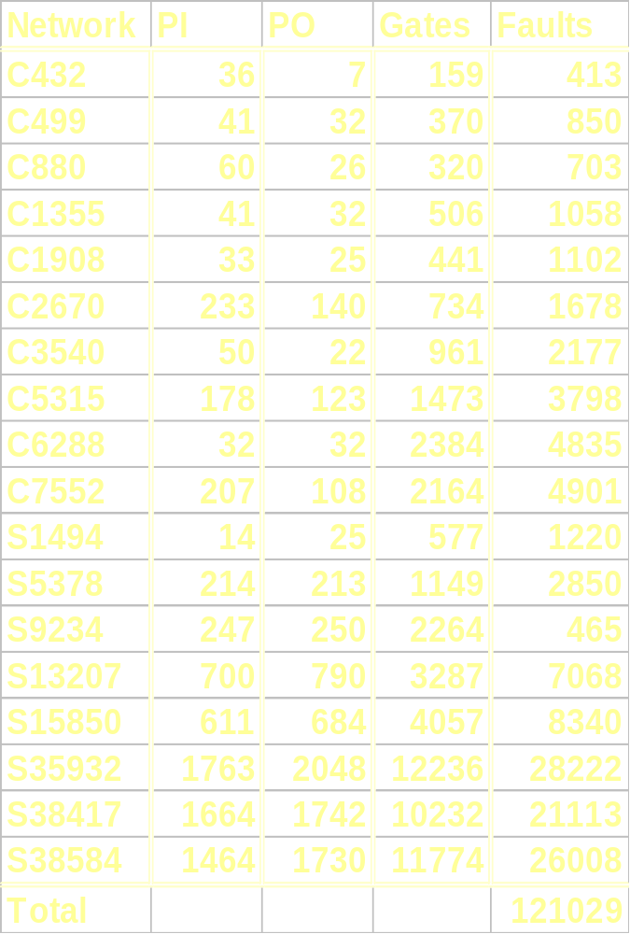
Benchmark Networks
MCNC Test Generation Benchmarks
Full scan assumed for sequential networks

Slide 44
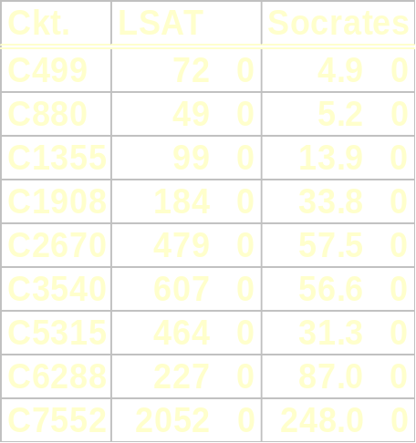
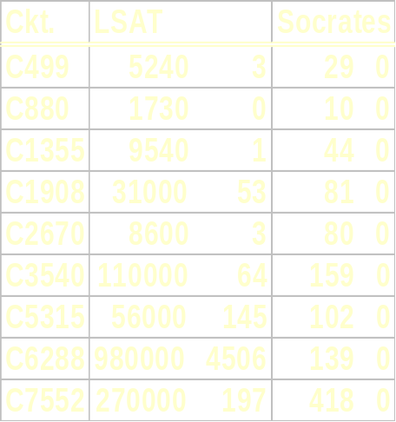
Larrabee’s Heurictics
With random tests
(seconds | # aborts)
Without random tests
(seconds | # aborts)

Slide 45
Greedy Heuristics
Heuristics must be evaluated without using random tests
Static variable ordering is not effective
Dynamic ordering can require too much computation at each branch of the search
Solution: greedy, dynamic orderings.
At each branch point, select:
  1st literal in 1st unsatisfied clause
  last literal in 1st unsatisfied clause
  1st literal in last unsatisfied clause
  last literal in last unsatisfied clause
Results: improved performance and robustness

Slide 46
Algorithm
For each uncaught fault:
    extract CNF formula
    try 4 greedy strategies
    if all fail then
      find static NLI (non local implications)
      repeat 4 strategies
    endif
    if satisfied then
      fault simulate test (to see what other faults are caught)
    else
      flag possible redundant fault
    endif
Simple algorithm:
  no testability measures
  no 5,9-valued algebras
  no multiple backtracking
Standalone program TEGUS
(also in sis 1.1, but slower by 1-2 orders of magnitude)

Slide 47
Experiments
Theoretical worst case performance is same for all complete  algorithms
Heuristics must be evaluated by experiment
To compare heuristics:
  use the 10 ISCAS’85 benchmark networks and 8 larger ISCAS’89 networks (assuming full scan)
  Run on same model computer as other reported results with same options
  Compare CPU time (not backtracks)
  Try with and without random tests

Slide 48
TEGUS Base Results
Robust: 0 aborted faults in ISCAS’85/’89 networks without fault simulation
Efficient: for 18 ISCAS networks
  no fault simulation: 10 min. total CPU*
  75% extract, 25% SAT
  with random: 1 min. total CPU*
  55% extract, 20% fault sim, 15% SAT, 10% I/O
  10 MB peak memory
Simple: 3k lines of code
  300 to extract CNF formula
  800 for SAT package
*(DEC 3000/500)

Slide 49
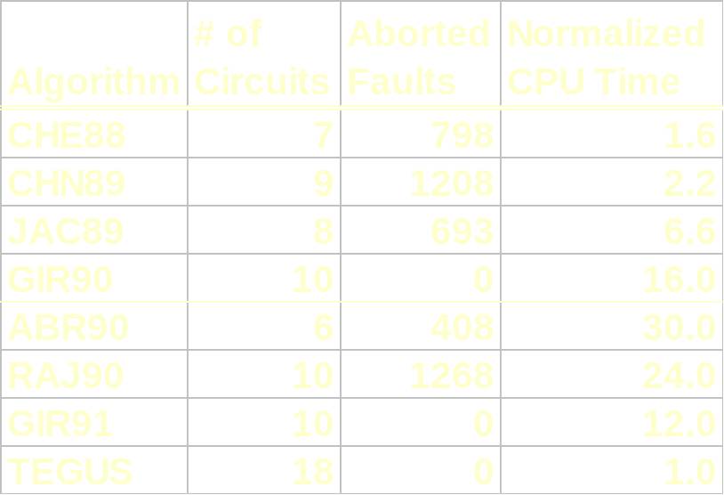
Robustness
Available results with no fault simulation for ISCAS’85/’89 networks
Algorithms with backtrack limits are incomplete
Heuristics which abort on fewer faults are more robust

Slide 50
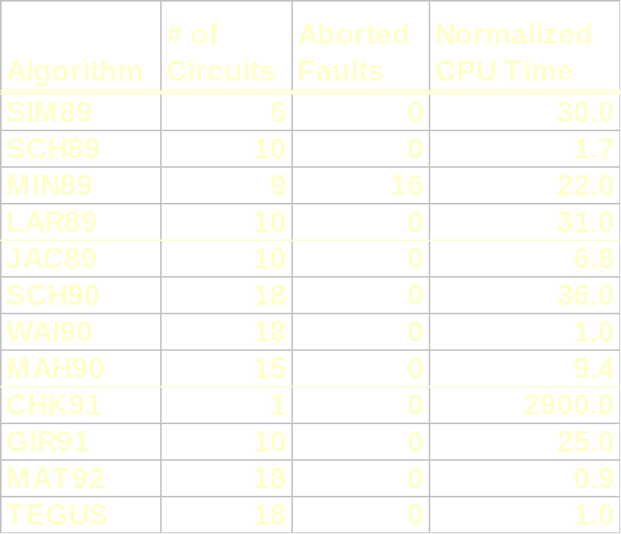
Efficiency
Available results with random tests for ISCAS’85/’89 networks
See Tech Report UCB/ERL M92/112 or TCAD Sept. 96, Vol 15, N0.9, 1167-1175
Random tests mask effectiveness of deterministic algorithm

Slide 51
SAT Conclusions
Hybrid test generation algorithm extracts CNF formula for structural fault, and applies generic SAT algorithm to generate a test
Greedy, dynamic ordering heuristics are as efficient as best published results for structural algorithms
Heuristics must be carefully compared using real implementations and without random tests
Other fault models and test restrictions can be accommodated without modifying the generic SAT solver

